Slide 1


Fraction Domain
Grade 3
Sandi Campi, Mississippi Bend AEA
Nell Cobb, DePaul University

Slide 2
Goals of the Module
Enhance participant’s understanding of fractions as numbers.
Increase participant’s ability to use visual fraction models to solve problems.
Increase participants ability to teach for understanding of fractions as numbers.

Slide 3
Something to think about … (1)
Suppose four speakers are giving a presentation that is 3 hours long; how much time will each person have to present if they share the presentation time equally?
Notes:
The problem is taken from NTCM (2010) Developing essential understanding of rational numbers, page 24 – 25.

Slide 4
Solve this problem individually.
Create a representation (picture, diagram, model)of your answer.
Share at your table.
Notes:
Post a representative set of responses to the task in the room for reference to strategies and other content during this training. For now, use discussion questions on next slide.

Slide 5
Questions for Discussion
Create a group poster summarizing the various ways your group solved the problem.
What do you notice about the solutions?
What solutions are similar? How are they similar?
Notes:
Participants should note some made area models, some made linear time or number line models, and make connections between representations. Some participants may note that ¾ is the answer because of the conditions of 4 people sharing 3. Treat this as a conjecture for seeing if this is always true as most people will probably not make this connection in an audience made up of elementary teachers.

Slide 6
The Area Model
The area model representation for the result “each speaker will have ¾ of an hour for the 3 hour presentation”:
Notes:
You could discuss the area models for ¾ are dependent on knowing what the whole is. Without specifying the whole it is not reasonable to ask what fraction is represented by the shaded area. If the green area is the whole, the blue and green shaded area represents the fraction 3/2; if the entire rectangle is the whole, the shaded area represents ¾. It might be a good place to discuss the problem with traditional textbooks always using an area model and breaking fraction quantities into parts and wholes implying a fraction is made up of two whole numbers, which is a misconception.

Slide 7
The Number Line Model
The number line model for the result “each speaker will have ¾ of an hour for the 3 hour presentation”:
_____________
1 2 3 (figure 1)
_____________
1 2 3 (figure 2)
Notes:
The red line represents the amount of time for speaker 1, the yellow line for speaker 2, and the light blue line for speaker three. The black lines are the remaining time for speaker 4 but not distributed. Participants should explain the link between figure 1 and 2.

Slide 8
Connections
2.G.3 Partition circles and rectangles into two, three, or four equal shares, describe the shares using the words halves, thirds, half of, a third of, etc., and describe the whole as two halves, three thirds, four fourths. Recognize that equal shares of identical wholes need not have the same shape.
Notes:
Notice the focus on the shape and quantity without focus on notation. Traditional books tend to focus on parts and whole language that makes it hard for students to see fractions as a quantity. “Note fractions do not have a single meaning, such as n parts out of m parts. They can stand for relationships between amounts or processes involving amounts or points on a number line. When children learn to think of fractions as parts of wholes, it is hard for them to grasp what really makes a fraction what it is” from Levi and Empson, Extending Children’s Mathematics: Fractions and Decimals, pages xxi-xxii. It is important to have students relate the name of the parts as coming from how many time it fits into the unit or whole.

Slide 9
Connections
3.OA.2 Interpret whole-number quotients of whole numbers, e.g., interpret 56 ÷ 8 as the number of objects in each share when 56 objects are partitioned equally into 8 shares, or as a number of shares when 56 objects are partitioned into equal shares of 8 objects each.
  For example, describe a context in which a number of shares or a number of groups can be expressed as 56 ÷ 8.
Notes:
This problem type prepares students for work with fractions. They help students develop the idea of a group as a type of unit that can be partitioned or put into smaller units.

Slide 10
Domain:
  Number and Operations –Fractions 3.NF
Cluster:
  Develop Understanding of Fractions as Numbers
Notes:
It is important to read and reflect on the cluster headings. This set of standards is developing understanding or a definition for what a fraction is.

Slide 11
3.NF.1 Understand a fraction 1/b as the quantity formed by 1 part when a whole is partitioned into b equal parts; understand a fraction a/b as the quantity formed by a parts of size 1/b.
Notes:
This is a place where you can have participants can make the connection to the 3.NF.1. Using the opening problem, relate how this standard is applied. The quantity a/b is the ¾ of an hour made of ¼ increments as we saw in the number line.

Slide 12
Exploring the Standard
Replace the letters with numbers if it helps you.
With a partner, interpret the standard and describe what it looks like in third grade. You may use diagrams, words or both.
Write your response on a poster.
Notes:
What evidence would show a student understood these important ideas? We will continue to explore this question as we work with more problems.

Slide 13
Something to think about …
Equal Shares
Solve using as many ways as you can:
  Twelve brownies are shared by 9 people. How many brownies can each person have if all amounts are equal and every brownie is shared?
Notes:
This problem type is familiar to students and allows for developing understanding of how a fraction represents a quantity and how it relates to the whole. The numbers chosen for each problem presents different opportunities for understanding the standard.

Slide 14
Questions for Discussion
Create a group poster summarizing the various ways your group solved the problem.
What equations can you write based on these solutions?
What fraction ideas come from this problem because of the number choices?
Notes:
There should be opportunities for these fraction ideas:
Equivalence of 12/9 and 1 and 3/9
Use of unit fractions when distributing 1/9 for 12 people to create 1/9 + 1/9 + 1/9….
Ratio thinking if some think of sharing 4 brownies with 3 people as being the same relationship.
Equivalence for 3/9 and 1/3

Slide 15
Context Matters
What contexts help students partition?
  Candy bars
  Pancakes
  Sticks of clay
  Jars of paint
Notes:
To plan instruction using equal shares, first consider what contexts students are familiar with.
Brainstorm with teachers a continuing list of relevant contexts for students. Because presentations in the opening problem were a context teachers understood, it helped form representations for our first problem. Students need the same sort of support for understanding.

Slide 16
Sample Problems
4 children want to share 13 brownies so that each child gets the same amount. How much can each child get?
4 children want to share 3 oranges so that everyone gets the same amount. How much orange does each get?
12 children in art class have to share 8 packages of clay so that each child gets the same amount. How much clay can each child have?
Notes:
Each of these problems has a different idea that it supports. Solve each one. Are there any patterns to your answers?
When 4 share 13 a mixed number or fraction more than one results.
When 4 share 3, a fraction less than one results
When 12 share 8, there are opportunities for equivalent fraction discussions.

Slide 17
Make a Conjecture
At your table discuss these questions:
  When solving equal share problems, what patterns do you see in your answers?
  Does this always happen?
  Why?
Notes:
We are hoping to reveal the connection between the number of sharers and the objects shared that results in the answer to the problem: The number of objects shared is the numerator and the number of sharers is the denominator. This is occurring because fractions represent division and numerators and denominators have a multiplicative relationship.

Slide 18
Features of Instruction
Use equal sharing problems with these features for introducing fractions:
  Answers are mixed numbers and fractions less than 1
  Denominators or number of sharers should be 2,3,4,6,and 8*
  Focus on use of unit fractions in solutions and notation for them (new in 3rd)
  Introduce use of equations made of unit fractions for solutions
Notes:
Based on work of Susan Epson and Linda Levi. From Extending Children’s Mathematics Fractions and Decimals, Heinemann, 2011.
* These denominators are identified for third grade in the common core.

Slide 19
Group Work
Create some equal shares problems that have problem features described on the previous slide.
Organize the problems by features to best support the development of learning for the standard for grade 3. Which problems would come first? Which problems would come later?
Notes:
Facilitate work with teachers to allow them to create a unit or sequence of problems that would allow students to grow in understanding of the standard.

Slide 20
How do children think about fractions?
Notes:
Embed video 11 in quick time or use other video available of students solving problems with fractions.

Slide 21
Children’s Strategies
No coordination between sharers and shares
Trial and Error coordination
Additive coordination: sharing one item at a time
Additive coordination: groups of items
Ratio
  Repeated halving with coordination at end
  Factor thinking
Multiplicative coordination
Notes:
From Extending Children’s Mathematics: Fractions and Decimals, page 25. See resource slide at end of presentation.
See additional examples of these strategies in folder in Drop Box for this standard from Arizona workshop.

Slide 22
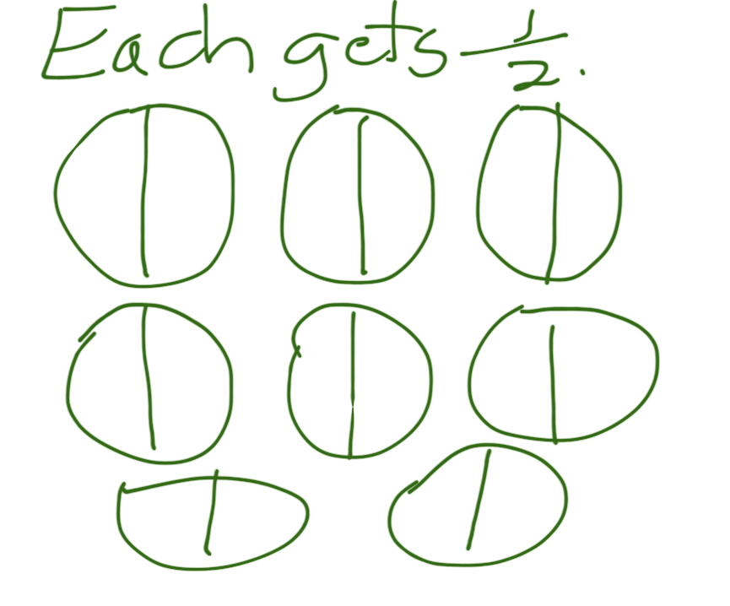
No Coordination
Notes:
Child either doesn’t attend to both the number of sharers or the number of objects at the same time.

Slide 23
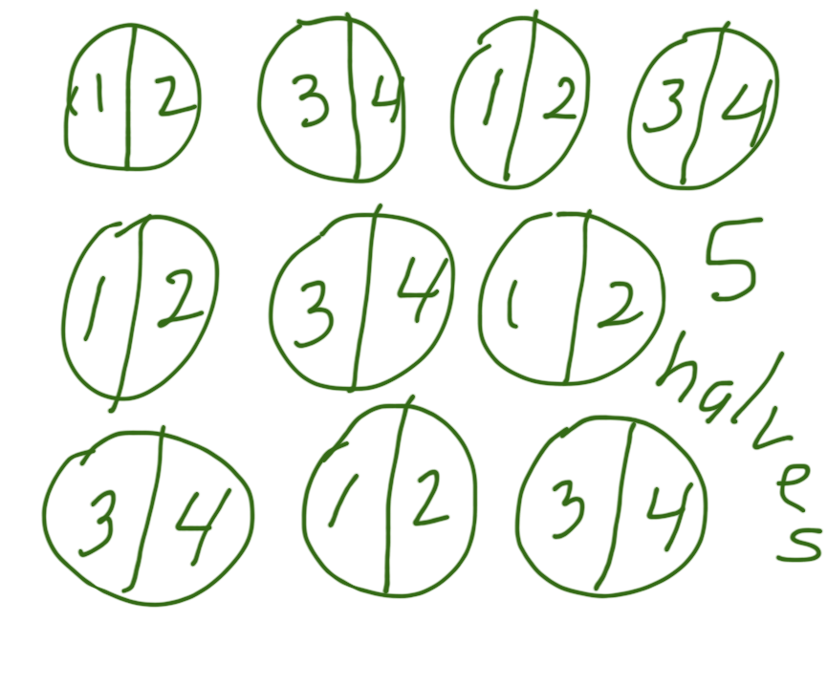
Trial and Error
Notes:
Child uses repeated halves because that is familiar and easy to think about first. If this didn’t work, they might halve again. Trial and error example.

Slide 24
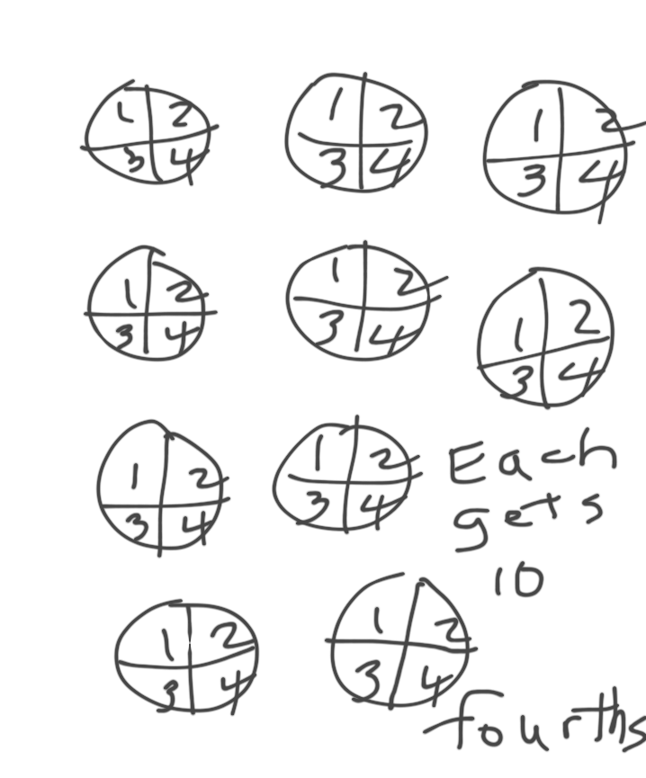
Additive Coordination
Notes:
Student recognizes each piece is shared among 4 and needs to be divided into 4 as a result.

Slide 25
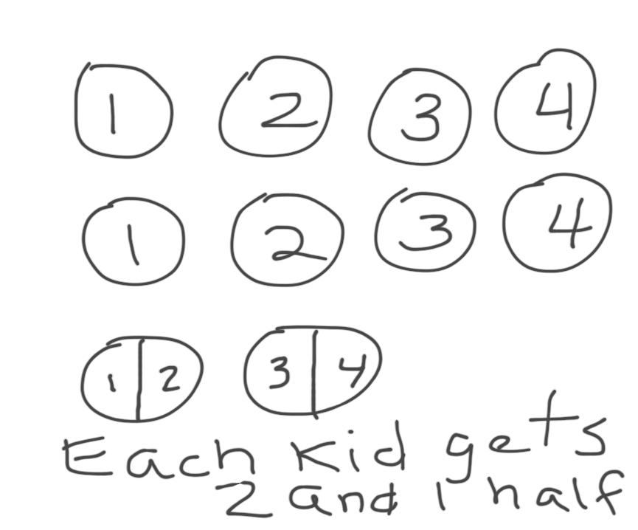
Additive Coordination of Groups
Notes:
Student notices wholes can be shared first and then divides what is left. Could also recognize multiple groups of items can be shared efficiently. For example, four pieces can come from two wholes when split into two halves.

Slide 26
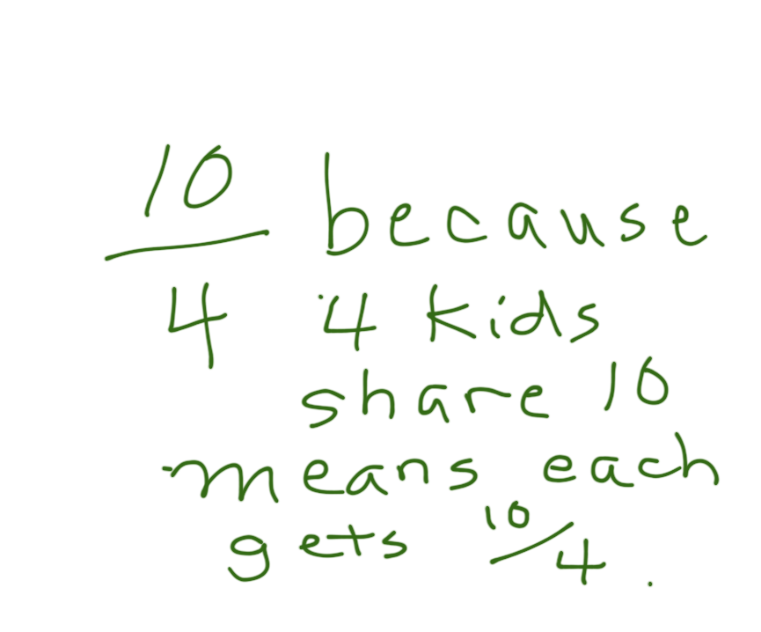
Multiplicative Coordination
Notes:
Understands fractions as division

Slide 27
The Importance of Mathematical Practices

Slide 28
Introduction to The Standards for Mathematical Practice
Notes:
This is the Hunt Video with Bill McCallum.

Slide 29
MP 1: Make sense of problems and persevere in solving them.
Mathematically Proficient Students:
Explain the meaning of the problem to themselves
Look for entry points
Analyze givens, constraints, relationships, goals
Make conjectures about the solution
Plan a solution pathway
Consider analogous problems
Try special cases and similar forms
Monitor and evaluate progress, and change course if necessary
Check their answer to problems using a different method
Continually ask themselves “Does this make sense?”
Gather Information
Make a plan
Continuously evaluate progress
Check results
Question sense of solutions
Anticipate possible solutions

Slide 30
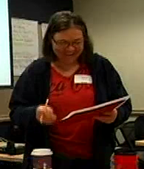
MP 2: Reason abstractly and Quantitatively
Decontextualize
Represent as symbols, abstract the situation
Contextualize
Pause as needed to refer back to situation
5
Mathematical Problem
½
P
x x x x
TUSD educator explains SMP #2 - Skip to minute 5

Slide 31
MP 3: Construct viable arguments and critique the reasoning of others
Use assumptions, definitions, and previous results
Make a conjecture
Build a logical progression of statements to explore the conjecture
Analyze situations by breaking them into cases
Recognize and use counter examples
Distinguish correct logic
Communicate conclusions
Explain flaws
Justify conclusions
Respond to arguments
Ask clarifying questions

Slide 32
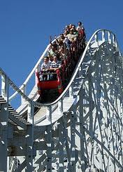
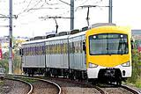
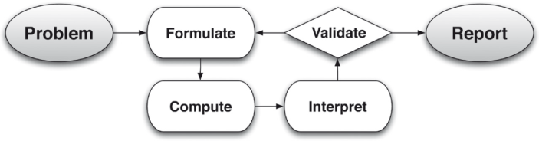
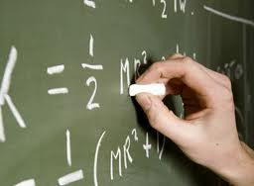
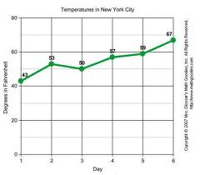
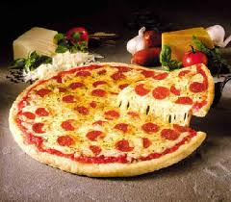
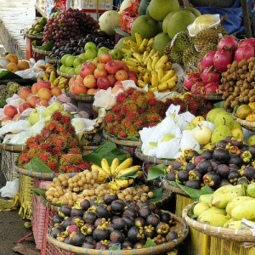
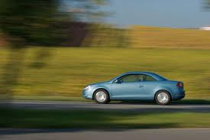
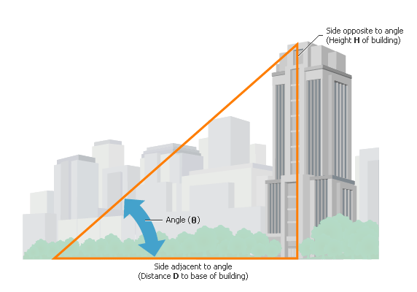
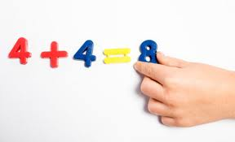
MP 4: Model with mathematics
Problems in everyday life…
…reasoned using mathematical methods
Mathematically proficient students:
Make assumptions and approximations to simplify a Situation, realizing these may need revision later
Interpret mathematical results in the context of the situation and reflect on whether they make sense

Slide 33

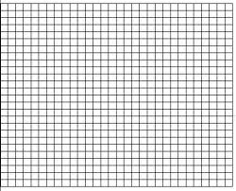
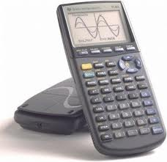
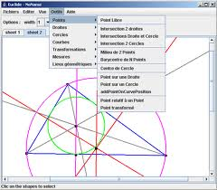
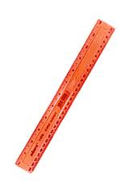
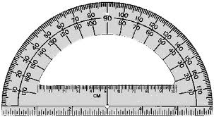
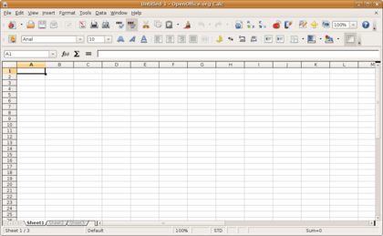
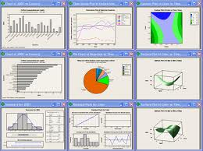
MP 5: Use appropriate tools strategically
Proficient students:
Are sufficiently familiar with appropriate tools to decide when each tool is helpful, knowing both the benefit and limitations
Detect possible errors
Identify relevant external mathematical resources, and use them to pose or solve problems

Slide 34
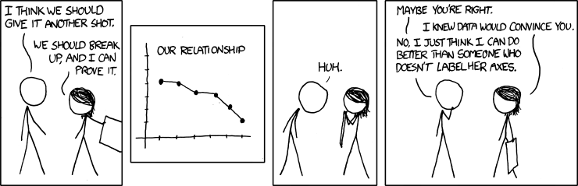
MP 6: Attend to Precision
Mathematically proficient students:
  communicate precisely to others
  use clear definitions
  state the meaning of the symbols they use
  specify units of measurement
  label the axes to clarify correspondence with problem
  calculate accurately and efficiently
  express numerical answers with an appropriate degree of precision
Comic: http://forums.xkcd.com/viewtopic.php?f=7&t=66819

Slide 35

MP 7: Look for and make use of structure
Mathematically proficient students:
  look closely to discern a pattern or structure
  step back for an overview and shift perspective
  see complicated things as single objects, or as composed of several objects

Slide 36
MP 8: Look for and express regularity in repeated reasoning
Mathematically proficient students:
  notice if calculations are repeated and look both for general methods and for shortcuts
  maintain oversight of the process while attending to the details, as they work to solve a problem
  continually evaluate the reasonableness of their intermediate results

